Slide 1

SWS3009
Lecture 3
Statistical Methods
colintan@nus.edu.sg

Slide 2
Introduction
Statistical methods, as the name implies, uses statistical formulae to learn from data and make predictions.
We will look at four major methods:
Regression.
Naïve Bayes Classification.
Decision Trees
Support Vector Machines.
This lecture gives you an alternative to neural networks and deep learning.
Statistical methods have better theoretical basis.
Statistical methods in general are faster to build and train.
Statistical methods usually have fewer hyper-parameters to adjust.
Statistical methods also give you a good idea whether the data is actually “learnable”
Much faster prototyping time, much simpler, though may provide relatively poor results.

Slide 3
REGRESSION : LINEAR models
SWS3009 Embedded Systems and Deep Learning

Slide 4
Statistical – Regression
In regression analysis:
We have data that shows the relationship between a dependent variable and one or more independent variables.
E.g. the relationship between population growth and time.
We want to estimate this relationship.
The relationship between the dependent variable and the independent variable can be a straight line (linear) or not (nonlinear).
We will only consider linear relationships with one independent variable (simple linear regression).
In the hands-on we will look at multivariable linear regression.
We skip non-linear regression as this is served well by neural networks and deep learning techniques that we have already seen.

Slide 5
Simple Linear Regression
Let’s suppose your company has data about sales figures versus GDP growth:
Independent variable: This is the variable that you cannot control. Here it is GDP growth.
Dependent variable: This is the variable you are interested in predicting, against the independent variable. Here it is sales.
Change in GDP | Sales
1 | 100
1.9 | 250
2.4 | 275
2.6 | 200
2.9 | 300

Slide 6
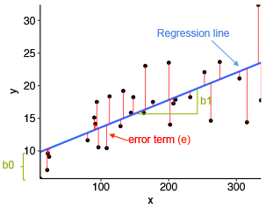
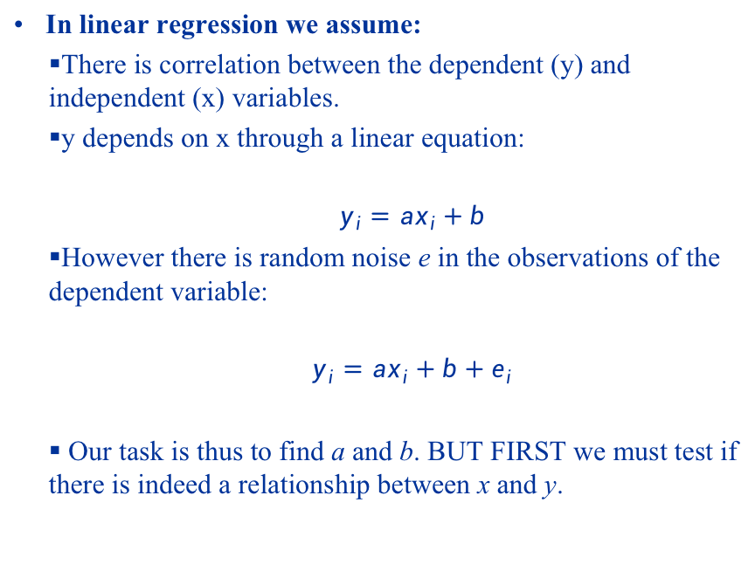
Simple Linear Regression Assumptions
In linear regression we assume:
There is correlation between the dependent (y) and independent (x) variables.
y depends on x through a linear equation:
$$y_{i}=ax_{i}+b$$
However there is random noise e in the observations of the dependent variable:
$$y_{i}=ax_{i}+b+e_{i}$$
Our task is thus to find a and b. BUT FIRST we must test if there is indeed a relationship between x and y.

Slide 7
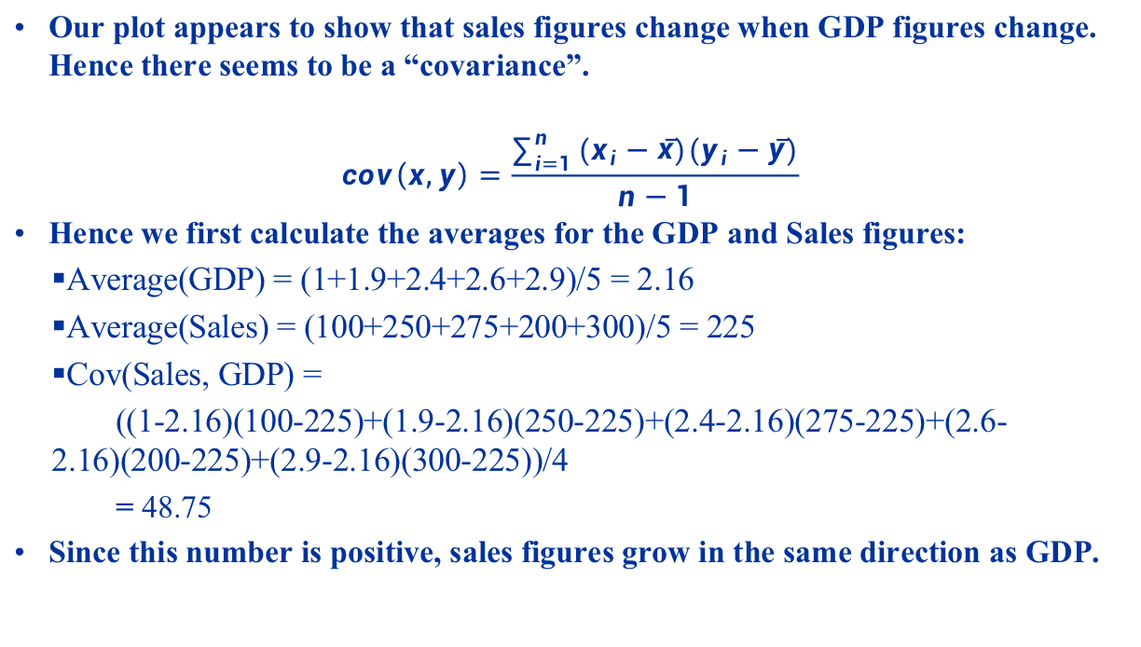
Simple Linear Regression Covariance
Our plot appears to show that sales figures change when GDP figures change. Hence there seems to be a “covariance”.
$$cov\left(x,y\right)=\frac{\sum_{i=1}^{n}{(x_{i}−\overline{x})(y_{i}−\overline{y})}}{n−1}$$
Hence we first calculate the averages for the GDP and Sales figures:
Average(GDP) = (1+1.9+2.4+2.6+2.9)/5 = 2.16
Average(Sales) = (100+250+275+200+300)/5 = 225
Cov(Sales, GDP) =
((1-2.16)(100-225)+(1.9-2.16)(250-225)+(2.4-2.16)(275-225)+(2.6-2.16)(200-225)+(2.9-2.16)(300-225))/4
= 48.75
Since this number is positive, sales figures grow in the same direction as GDP.

Slide 8
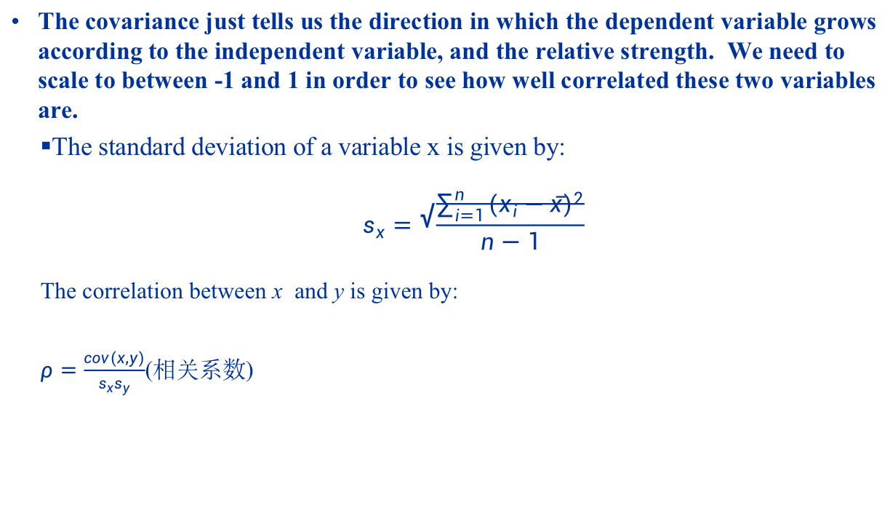
Simple Linear Regression Correlation
The covariance just tells us the direction in which the dependent variable grows according to the independent variable, and the relative strength. We need to scale to between -1 and 1 in order to see how well correlated these two variables are.
The standard deviation of a variable x is given by:
$$s_{x}=\sqrt{\frac{\sum_{i=1}^{n}{{(x_{i}−\overline{x})}^{2}}}{n−1}}$$
The correlation between x and y is given by:
$ρ=\frac{cov(x,y)}{s_{x}s_{y}}$(相关系数)

Slide 9
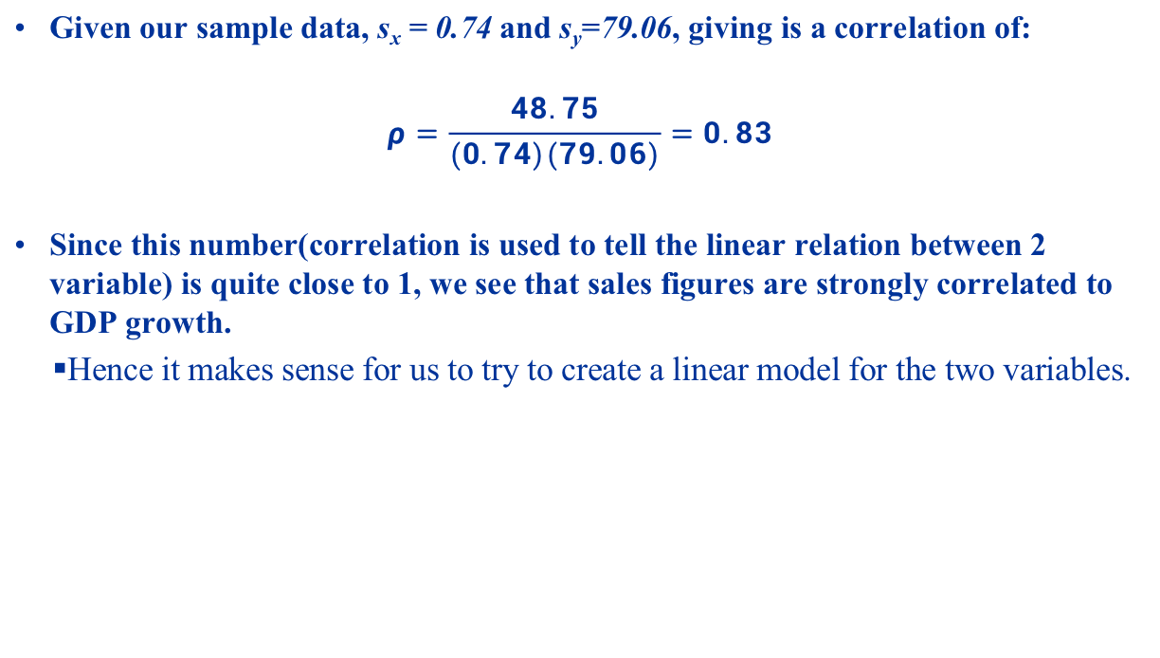
Simple Linear Regression Correlation
Given our sample data, s_{x} = 0.74 and s_{y}=79.06, giving is a correlation of:
$$ρ=\frac{48.75}{(0.74)(79.06)}=0.83$$
Since this number(correlation is used to tell the linear relation between 2 variable) is quite close to 1, we see that sales figures are strongly correlated to GDP growth.
Hence it makes sense for us to try to create a linear model for the two variables.

Slide 10
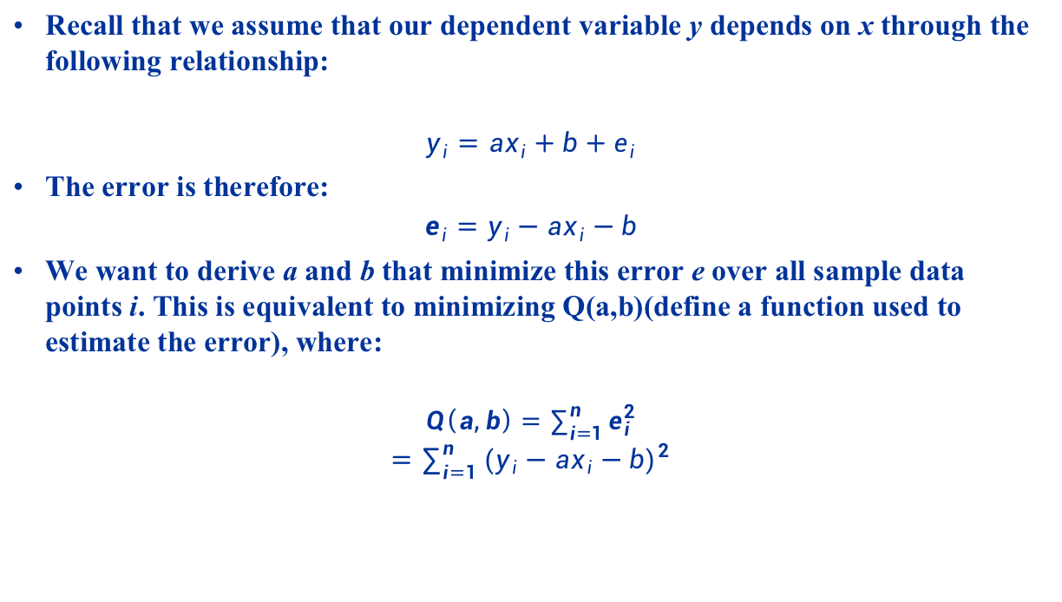
Simple Linear Regression Parameter Estimation
Recall that we assume that our dependent variable y depends on x through the following relationship:
$$y_{i}=ax_{i}+b+e_{i}$$
The error is therefore:
$$e_{i}=y_{i}−ax_{i}−b$$
We want to derive a and b that minimize this error e over all sample data points i. This is equivalent to minimizing Q(a,b)(define a function used to estimate the error), where:
$$Q\left(a,b\right)=\sum_{i=1}^{n}{e_{i}^{2}}$$
$$=\sum_{i=1}^{n}{{{(y}_{i}−ax_{i}−b)}^{2}}$$

Slide 11
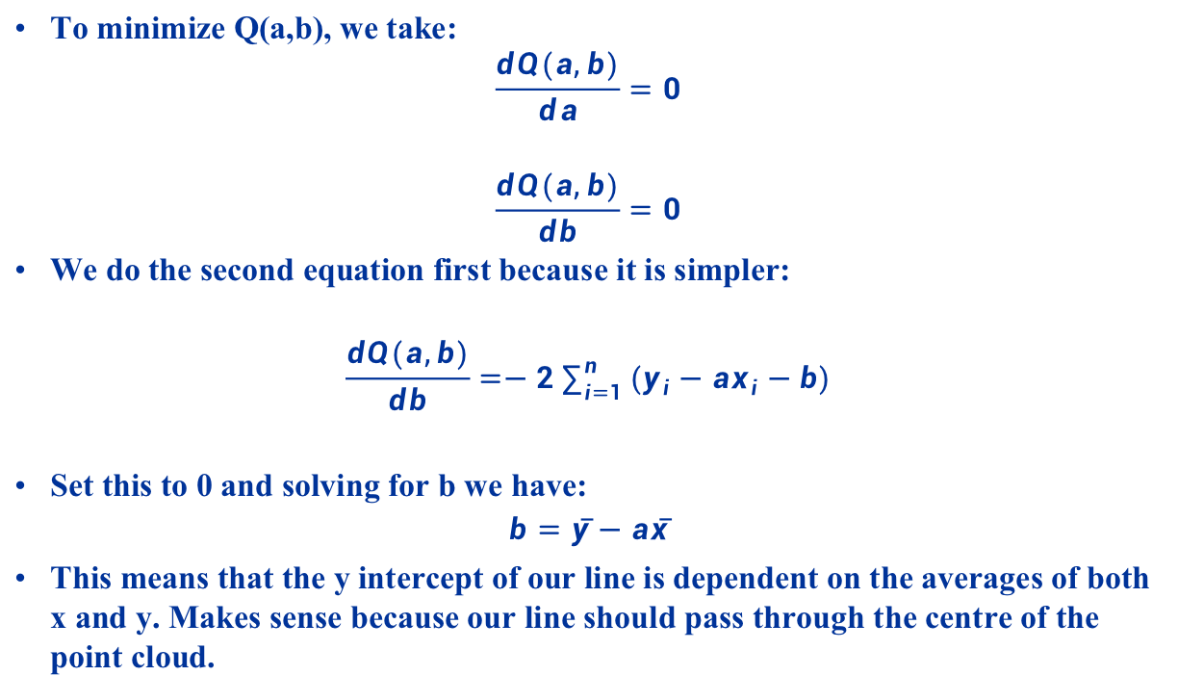
Simple Linear Regression Parameter Estimation
To minimize Q(a,b), we take:
$$\frac{dQ(a,b)}{da}=0$$
$$\frac{dQ(a,b)}{db}=0$$
We do the second equation first because it is simpler:
$$\frac{dQ(a,b)}{db}=−2\sum_{i=1}^{n}{(y_{i}−ax_{i}−b)}$$
Set this to 0 and solving for b we have:
$$b=\overline{y}−a\overline{x}$$
This means that the y intercept of our line is dependent on the averages of both x and y. Makes sense because our line should pass through the centre of the point cloud.

Slide 12
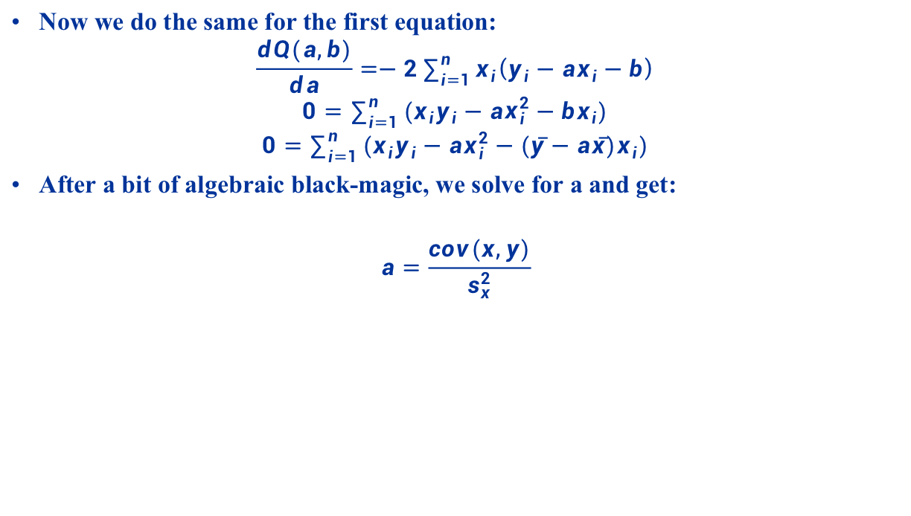
Simple Linear Regression Parameter Estimation
Now we do the same for the first equation:
$$\frac{dQ(a,b)}{da}=−2\sum_{i=1}^{n}{x_{i}\left(y_{i}−ax_{i}−b\right)}$$
$$0=\sum_{i=1}^{n}{(x_{i}y_{i}−ax_{i}^{2}−bx_{i})}$$
$$0=\sum_{i=1}^{n}{(x_{i}y_{i}−ax_{i}^{2}−(\overline{y}−a\overline{x})x_{i})}$$
After a bit of algebraic black-magic, we solve for a and get:
$$a=\frac{cov(x,y)}{s_{x}^{2}}$$

Slide 13
Simple Linear Regression Example
We are now able to find the regression line for our data:
Average GDP Growth = 2.16, Average Sales = 225
Cov(GDP, Sales) = 48.75, Var(GDP)=0.553
a = 48.75 / 0.553 = 88.16
b = 225 – 88.16 * 2.16 = 34.57
So our regression line is y = 88.16x + 34.57
If GDP growth this year is 2.5%, we can now predict sales of (88.16 * 2.5 + 34.57) = 255.1 units.
Change in GDP | Sales
1 | 100
1.9 | 250
2.4 | 275
2.6 | 200
2.9 | 300

Slide 14
CLASSIFICATION: NAÏVE BAYES METHOD
SWS3009 Embedded Systems and Deep Learning

Slide 15
Naïve Bayes Classifier
While linear regression is good for predicting the value of a dependent variable given an unknown independent variable, they cannot conveniently used for classification problems:
Classification Problem:
Given a set of data X, and a set of classes C, we want to compute the likelihood of some x ∈ X belongs to some class c_{k} ∈ C.
In particular, we want to find some c_{max} such that P(c_{max} | x) = max_{ck∈C} P(c_{k} |x), then we can claim that x belongs to class c_{max}.
E.g. problem:
X is a set of news articles, and x is one article.
C is a set of news article types, e.g. sports, politics, home news, crime, etc.
Our task then is to decide what kind of article x is.
In the trial lecture we built a Perceptron to classify between lorries and vans. Naïve-Bayers classifiers are a convenient, theoretically-based alternative to Perceptrons.

Slide 16
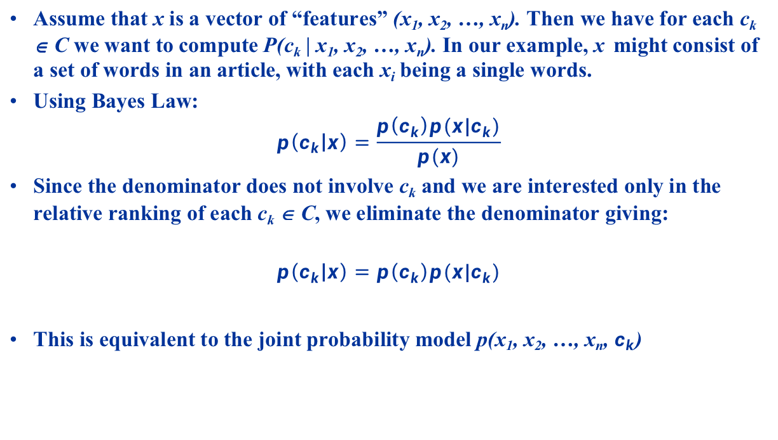
Naïve Bayes Classifier Assumptions
Assume that x is a vector of “features” (x₁, x₂, …, x_{n}). Then we have for each c_{k} ∈ C we want to compute P(c_{k} | x₁, x₂, …, x_{n}). In our example, x might consist of a set of words in an article, with each x_{i} being a single words.
Using Bayes Law:
$$p\left(c_{k} | x\right)=\frac{p\left(c_{k}\right)p(x|c_{k})}{p(x)}$$
Since the denominator does not involve c_{k} and we are interested only in the relative ranking of each c_{k} ∈ C, we eliminate the denominator giving:
$$p\left(c_{k} | x\right)=p\left(c_{k}\right)p(x|c_{k})$$
This is equivalent to the joint probability model p(x₁, x₂, …, x_{n}, $c_{k}$)

Slide 17

Naïve Bayes Classifier Assumptions
Using the chain-rule:
$$p\left(c_{k},x_{1}\text{,}x_{2}\text{, }\text{…,}x_{n}\text{)=}\text{p}\text{(}x_{1} | x_{2},x_{3}, …, c_{k}\right)p\left(x_{2} | x_{3}, …,c_{k}\right)…p\left(x_{n} | c_{k}\right)p\left(c_{k}\right)$$
In practice the joint probabilities p(x₁|x₂,…,c_{k}) etc. are difficult to estimate, and thus we make the naïve assumption that all x_{i} terms are independent. Thus each p(x_{i}|x_{i+1,} …, x_{n},c_{k}) = p(x_{i}|c_{k})
This gives us the final form for the Naïve Bayes Classifier
$$p\left(c_{k} | x_{1},x_{2},…,x_{n}\right)=p(c_{k})\prod_{i=1}^{n}{p(\text{x}\text{i}|c_{k})}$$

Slide 18
Naïve Bayes Classifier Parameter Estimation
Naïve Bayes Classifiers must be “trained” on training data before being able to classify a given sample.
Parameter Estimation:
We need to estimate p(c_{k}) for every c_{k} ∈ C:
Uniform Assumption: For n classes, the probability of p(c_{k}) is simply 1/n.
Based on training set: if there is a total of S training samples, and
s_{k} samples for class c_{k}, then p(c_{k}) = s_{k} / S.
Estimating p(x_{i}|c_{k}) is somewhat trickier. We will look at three approaches:
Gaussian: Assumes that the probability of a feature x_{i} taking a particular value v in class c_{k} follows a normal distribution.
Multinomial: Assumes that the frequency of a feature x_{i} occurring in a class is governed by a multinomial distribution.
Bernoulli: Assumes that the boolean (yes/no) occurrence of a feature x_{i} occurring in class c_{k} is governed by a Bernoulli distribution.

Slide 19
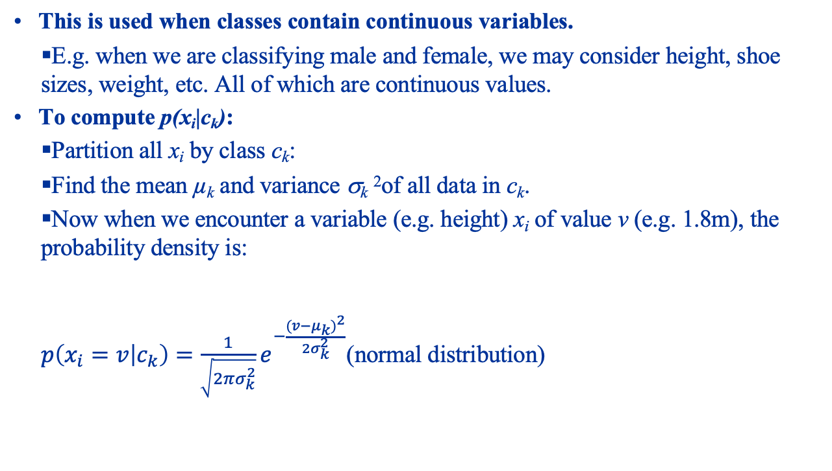
Normal Distribution Naïve Bayes Continuous Variables
This is used when classes contain continuous variables.
E.g. when we are classifying male and female, we may consider height, shoe sizes, weight, etc. All of which are continuous values.
To compute p(x_{i}|c_{k}):
Partition all x_{i} by class c_{k}:
Find the mean µ_{k} and variance σ_{k} ²of all data in c_{k}.
Now when we encounter a variable (e.g. height) x_{i} of value v (e.g. 1.8m), the probability density is:
$p\left(x_{i}=v | c_{k}\right)=\frac{1}{\sqrt{2πσ_{k}^{2}}}e^{−\frac{{(v−μ_{k})}^{2}}{{2σ}_{k}^{2}}}$(normal distribution)

Slide 20
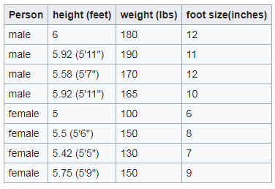
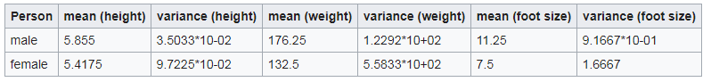
Normal Distribution Naïve Bayes Continuous Variables
Let’s take an example of classifying men and women based on height, weight and foot size (“borrowed” from Wikipedia):
From here we need to work out the mean and variance for each class to compute the Gaussian probability function:

Slide 21
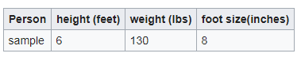
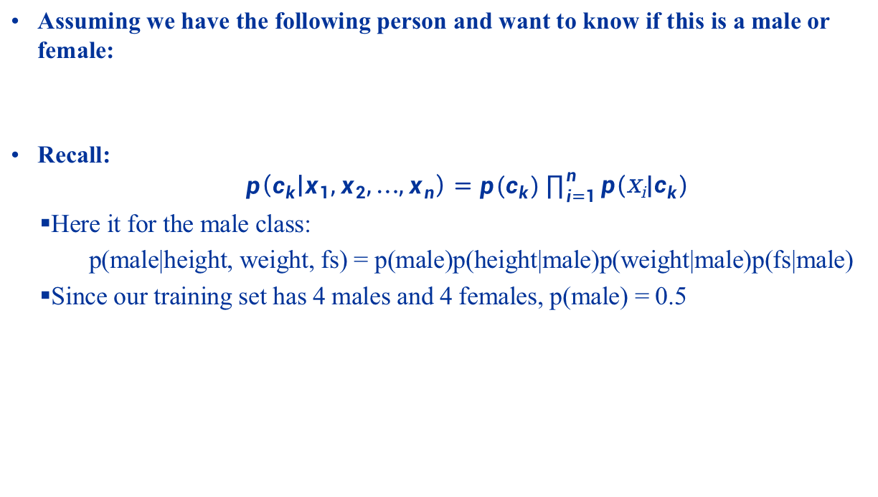
Normal Distribution Naïve Bayes Continuous Variables
Assuming we have the following person and want to know if this is a male or female:
Recall:
$$p\left(c_{k} | x_{1},x_{2},…,x_{n}\right)=p(c_{k})\prod_{i=1}^{n}{p(\text{x}\text{i}|c_{k})}$$
Here it for the male class:
p(male|height, weight, fs) = p(male)p(height|male)p(weight|male)p(fs|male)
Since our training set has 4 males and 4 females, p(male) = 0.5

Slide 22
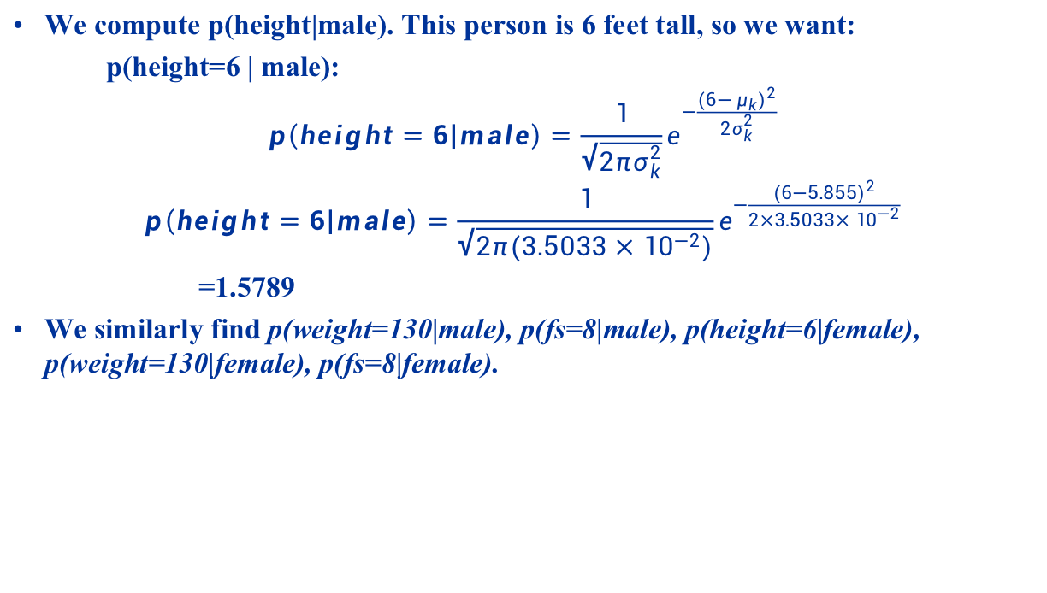
Normal Distribution Naïve Bayes Continuous Variables
We compute p(height|male). This person is 6 feet tall, so we want:
p(height=6 | male):
$$p\left(height=6 | male\right)=\frac{1}{\sqrt{2πσ_{k}^{2}}}e^{−\frac{{(6−μ_{k})}^{2}}{{2σ}_{k}^{2}}}$$
$$p\left(height=6 | male\right)=\frac{1}{\sqrt{2π(3.5033×{10}^{−2})}}e^{−\frac{{(6−5.855)}^{2}}{2×3.5033×{10}^{−2}}}$$
=1.5789
We similarly find p(weight=130|male), p(fs=8|male), p(height=6|female), p(weight=130|female), p(fs=8|female).

Slide 23
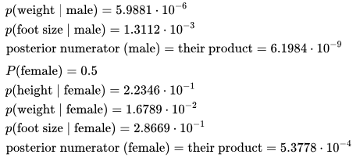
Normal Distribution Naïve Bayes Continuous Variables
We get the following results:
Since p(female|…) > p(male|…), we classify this person as “female”.

Slide 24
Multinomial Naïve Bayes Frequencies
In multinomial Naive Bayes, we consider an instance x to consist of a vector of frequencies (x₁, x₂, …, x_{n}) where each x_{i} is the frequency of some event i occurring.
E.g. in a document classification problem, x_{i} is the number of times word i appears.
Bag of words assumption:
A document is simply a collection of words.
We ignore sentence structure, context, etc.
The vector x is therefore a histogram of word frequencies.

Slide 25
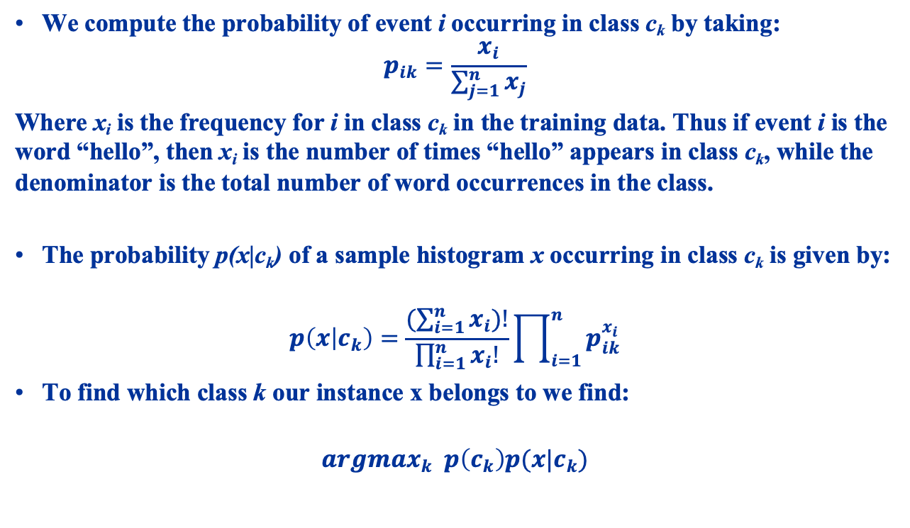
Multinomial Naïve Bayes Frequencies
We compute the probability of event i occurring in class c_{k} by taking:
$$p_{ik}=\frac{x_{i}}{\sum_{j=1}^{n}{x_{j}}}$$
Where x_{i} is the frequency for i in class c_{k} in the training data. Thus if event i is the word “hello”, then x_{i} is the number of times “hello” appears in class c_{k}, while the denominator is the total number of word occurrences in the class.
The probability p(x|c_{k}) of a sample histogram x occurring in class c_{k} is given by:
$$p\left(x | c_{k}\right)=\frac{(\sum_{i=1}^{n}{x_{i})!}}{\prod_{i=1}^{n}{x_{i}!}}\prod_{i=1}^{n}{p_{ik}^{x_{i}}}$$
To find which class k our instance x belongs to we find:
$${argmax}_{k} p\left(c_{k}\right)p(x|c_{k})$$

Slide 26
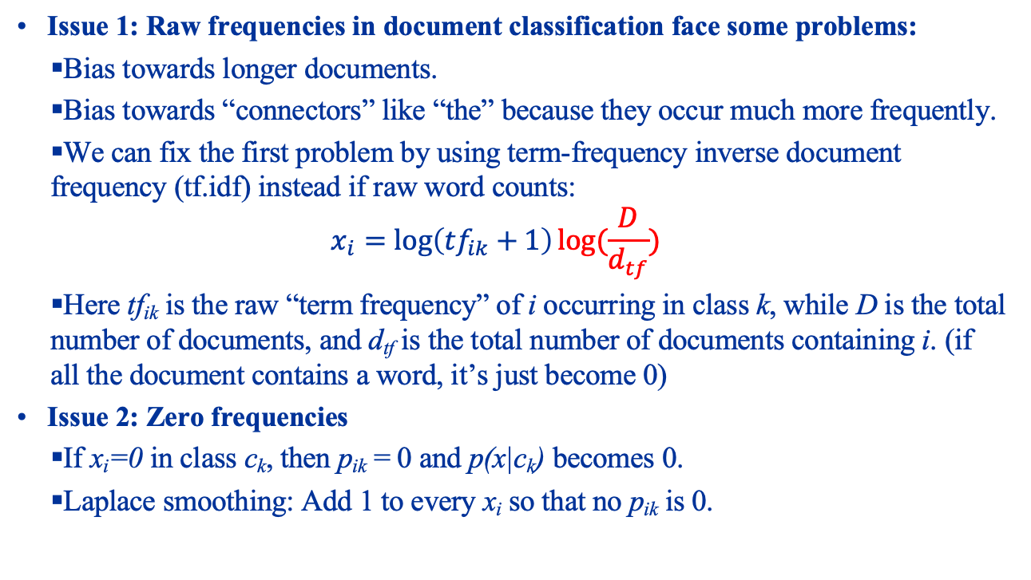
Multinomial Naïve Bayes Frequencies
Issue 1: Raw frequencies in document classification face some problems:
Bias towards longer documents.
Bias towards “connectors” like “the” because they occur much more frequently.
We can fix the first problem by using term-frequency inverse document frequency (tf.idf) instead if raw word counts:
$$x_{i}=\log\left({tf}_{ik}+1\right)log⁡(\frac{D}{d_{tf}})$$
Here tf_{ik} is the raw “term frequency” of i occurring in class k, while D is the total number of documents, and d_{tf} is the total number of documents containing i. (if all the document contains a word, it’s just become 0)
Issue 2: Zero frequencies
If x_{i}=0 in class c_{k}, then p_{ik} = 0 and p(x|c_{k}) becomes 0.
Laplace smoothing: Add 1 to every x_{i} so that no p_{ik} is 0.

Slide 27
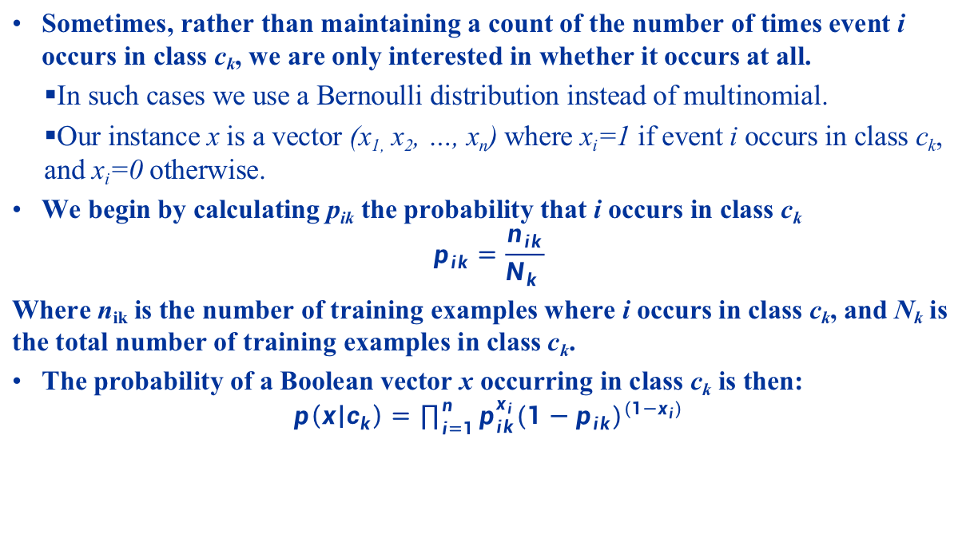
Bernoulli Naïve Bayes Boolean Features
Sometimes, rather than maintaining a count of the number of times event i occurs in class c_{k}, we are only interested in whether it occurs at all.
In such cases we use a Bernoulli distribution instead of multinomial.
Our instance x is a vector (x_{1,} x₂, …, x_{n}) where x_{i}=1 if event i occurs in class c_{k}, and x_{i}=0 otherwise.
We begin by calculating p_{ik} the probability that i occurs in class c_{k}
$$p_{ik}=\frac{n_{ik}}{N_{k} }$$
Where n_{ik} is the number of training examples where i occurs in class c_{k}, and N_{k} is the total number of training examples in class c_{k}.
The probability of a Boolean vector x occurring in class c_{k} is then:
$$p\left(x | c_{k}\right)=\prod_{i=1}^{n}{p_{ik}^{x_{i}}{(1−p_{ik})}^{(1−x_{i})}}$$

Slide 28
Naïve Bayes Hands-on
Start up Jupyter and load the “Naïve Bayes.ipynb” notebook.

Slide 29
Classification: Decision Trees
SWS3009 Embedded Systems and Deep Learning

Slide 30
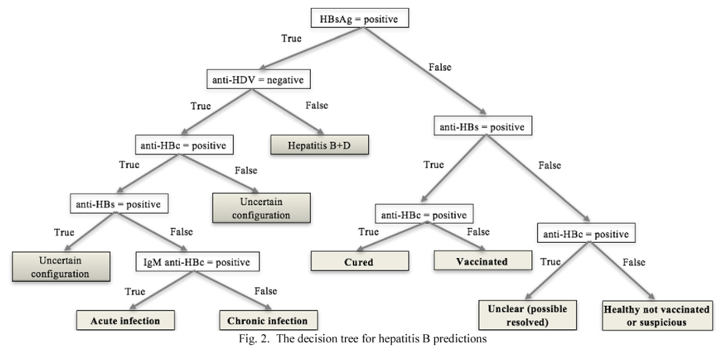
Decision Trees
A decision tree is a tree-like structure for making decisions:
A decision tree is appealing because:
It provides a straightforward way to make decisions.
It provides a way to explain decisions that have already been made.

Slide 31
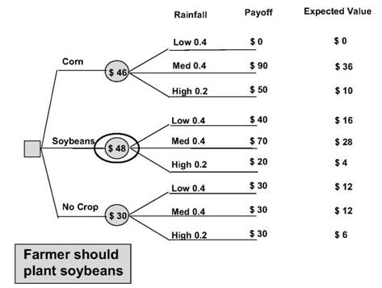
Decision Trees
Decision trees sometimes have probability values attached to them, allowing you to compute expected values of outcomes:
If there’s a 40% probability of low rainfall, a 40% probability of medium rainfall and 20% probability of high rainfall, with the payoff per acre of farmland as indicated in the “payoff” column, this chart helps the farmer to decide which is the best crop to plant (soybeans), based on expected revenue.

Slide 32

Decision Trees
Question:
How do you derive these trees?
Several ways:
Guesswork based on ‘expert’ opinion.
Based on historical data.
We will look at the second way.
Big shoutout:
Most of the materials from this section are taken, with permission, from Sefik Ilkin Serengil’s excellent blog on machine learning. If you are interested face recognition and other cool stuff, be sure to go over to:
https://sefiks.com/category/machine-learning/
Actual decision tree materials are at: https://sefiks.com/2017/11/20/a-step-by-step-id3-decision-tree-example/

Slide 33
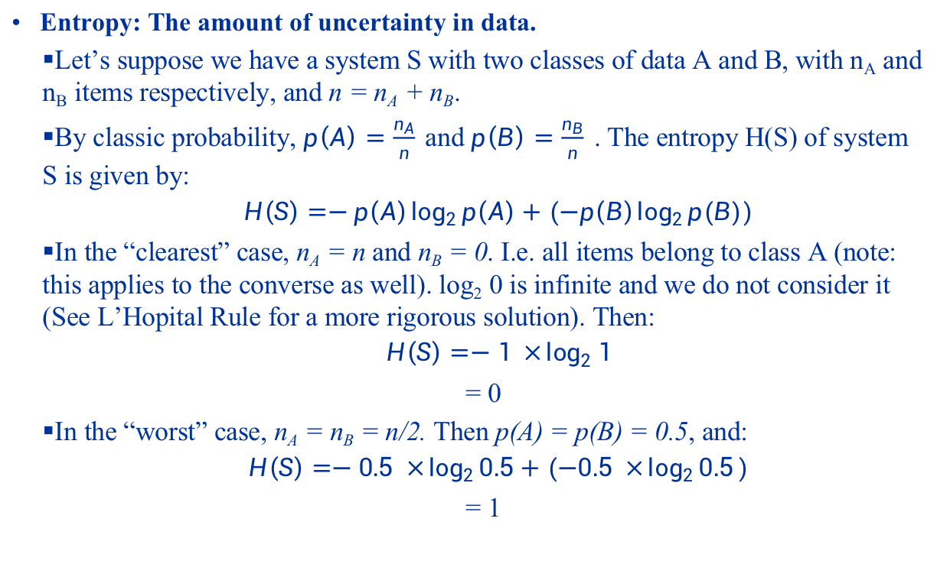
Deriving Decision Trees from Data
Entropy: The amount of uncertainty in data.
Let’s suppose we have a system S with two classes of data A and B, with n_{A} and n_{B} items respectively, and n = n_{A} + n_{B}.
By classic probability, $p\left(A\right)=\frac{n_{A}}{n}$and $p\left(B\right)=\frac{n_{B}}{n}$. The entropy H(S) of system S is given by:
$$H\left(S\right)=−p\left(A\right)\log_{2}{p\left(A\right)+(−p\left(B\right)\log_{2}{p(B))}}$$
In the “clearest” case, n_{A} = n and n_{B} = 0. I.e. all items belong to class A (note: this applies to the converse as well). log₂ 0 is infinite and we do not consider it (See L’Hopital Rule for a more rigorous solution). Then:
$$H\left(S\right)=−1 ×\log_{2}{1}$$
= 0
In the “worst” case, n_{A} = n_{B} = n/2. Then p(A) = p(B) = 0.5, and:
$$H\left(S\right)=−0.5 ×\log_{2}{0.5+(−0.5 ×\log_{2}{0.5}})$$
= 1

Slide 34
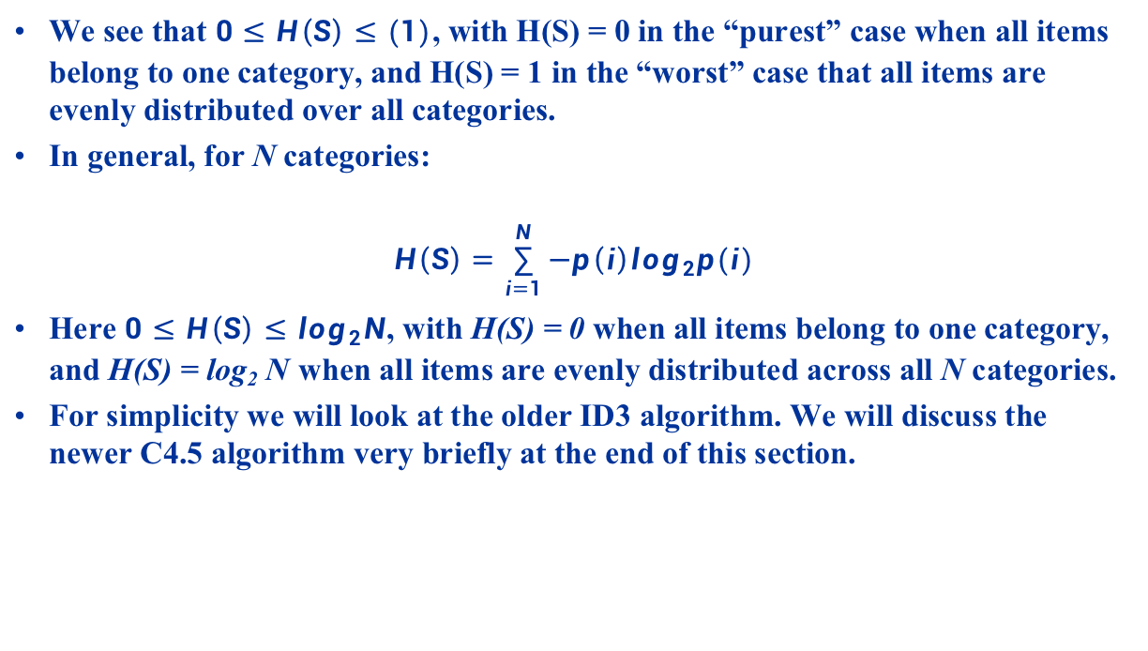
Deriving Decision Trees from Data
We see that $0≤H\left(S\right)≤(1)$, with H(S) = 0 in the “purest” case when all items belong to one category, and H(S) = 1 in the “worst” case that all items are evenly distributed over all categories.
In general, for N categories:
$$H\left(S\right)=\sum_{i=1}^{N}{−p\left(i\right)log_{2}p(i)}$$
Here $0≤H\left(S\right)≤log_{2}N$, with H(S) = 0 when all items belong to one category, and H(S) = log₂ N when all items are evenly distributed across all N categories.
For simplicity we will look at the older ID3 algorithm. We will discuss the newer C4.5 algorithm very briefly at the end of this section.

Slide 35
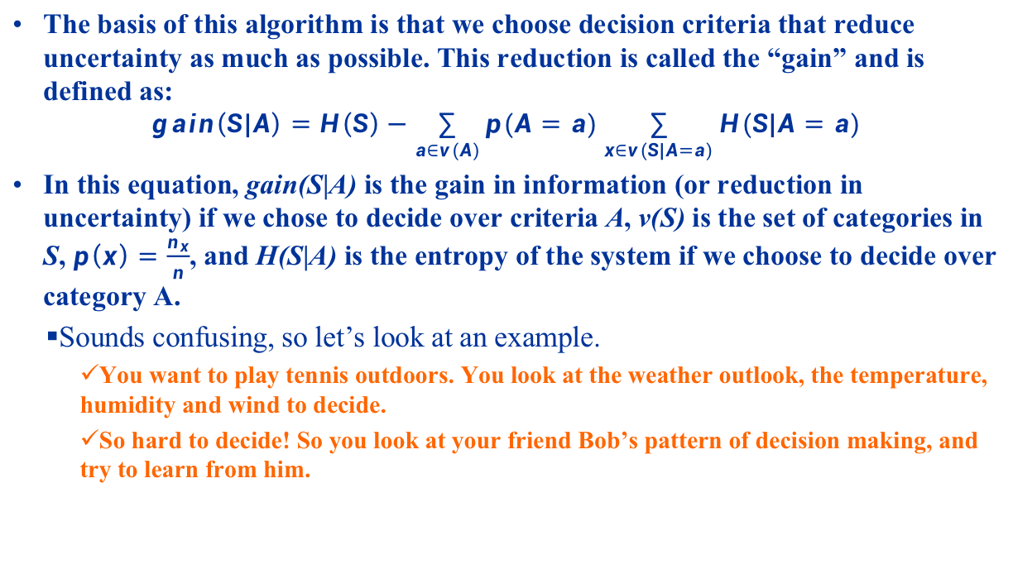
The ID3 Algorithm
The basis of this algorithm is that we choose decision criteria that reduce uncertainty as much as possible. This reduction is called the “gain” and is defined as:
$$gain\left(S|A\right)=H\left(S\right)−\sum_{a∈v(A)}{p(A=a)\sum_{x∈v(S|A=a)}{H(S|A=a)}}$$
In this equation, gain(S|A) is the gain in information (or reduction in uncertainty) if we chose to decide over criteria A, v(S) is the set of categories in S, $p\left(x\right)=\frac{n_{x}}{n}$, and H(S|A) is the entropy of the system if we choose to decide over category A.
Sounds confusing, so let’s look at an example.
You want to play tennis outdoors. You look at the weather outlook, the temperature, humidity and wind to decide.
So hard to decide! So you look at your friend Bob’s pattern of decision making, and try to learn from him.

Slide 36
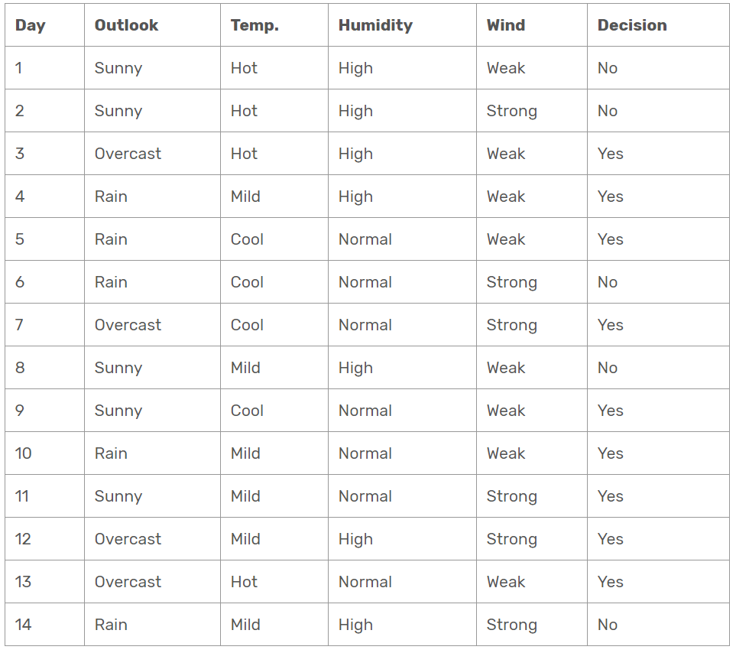
The ID3 Algorithm
Bob’s playing history for the past 14 days, based on weather, is shown in this table:

Slide 37
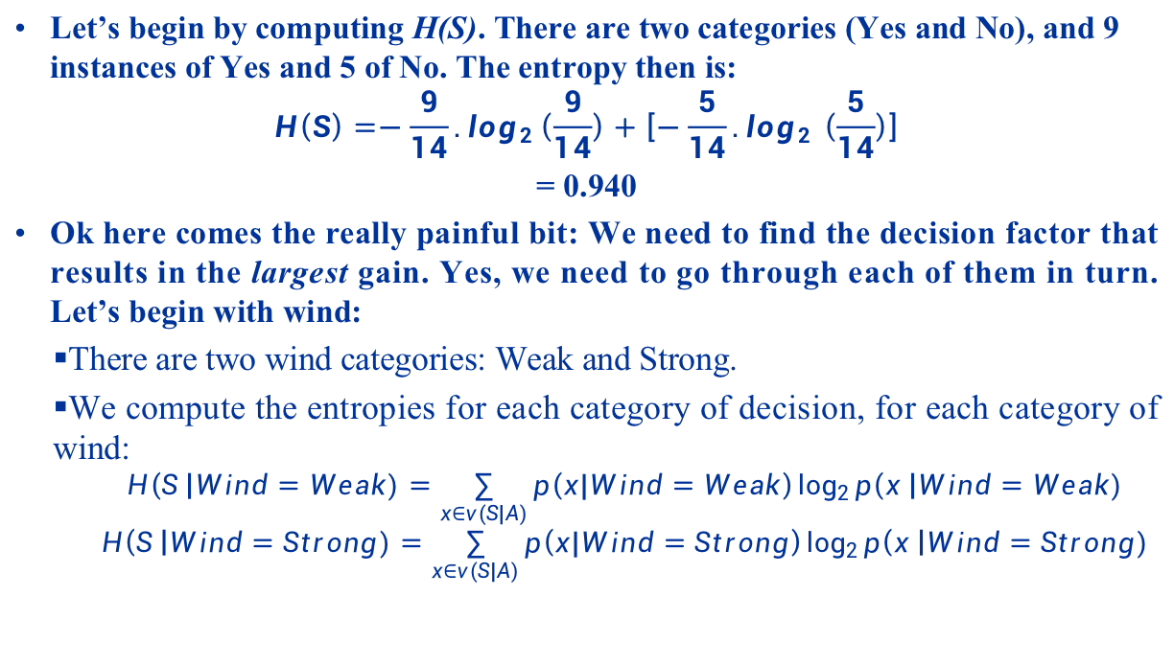
The ID3 Algorithm
Let’s begin by computing H(S). There are two categories (Yes and No), and 9 instances of Yes and 5 of No. The entropy then is:
$$H\left(S\right)=−\frac{9}{14}.log_{2}\left(\frac{9}{14}\right)+\left[−\frac{5}{14}.log_{2 }\left(\frac{5}{14}\right)\right]$$
= 0.940
Ok here comes the really painful bit: We need to find the decision factor that results in the largest gain. Yes, we need to go through each of them in turn. Let’s begin with wind:
There are two wind categories: Weak and Strong.
We compute the entropies for each category of decision, for each category of wind:
$$H\left(S \right|Wind=Weak)=\sum_{x∈v(S|A)}{p\left(x|Wind=Weak\right)\log_{2}{p\left(x \right|Wind=Weak)}}$$
$$H\left(S \right|Wind=Strong)=\sum_{x∈v(S|A)}{p\left(x|Wind=Strong\right)\log_{2}{p\left(x \right|Wind=Strong)}}$$

Slide 38
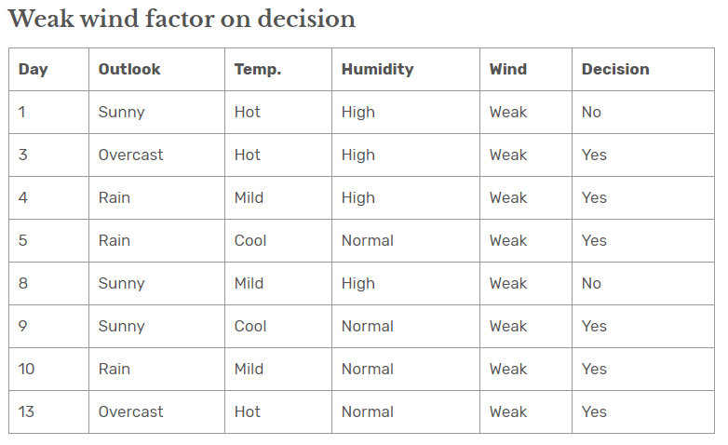
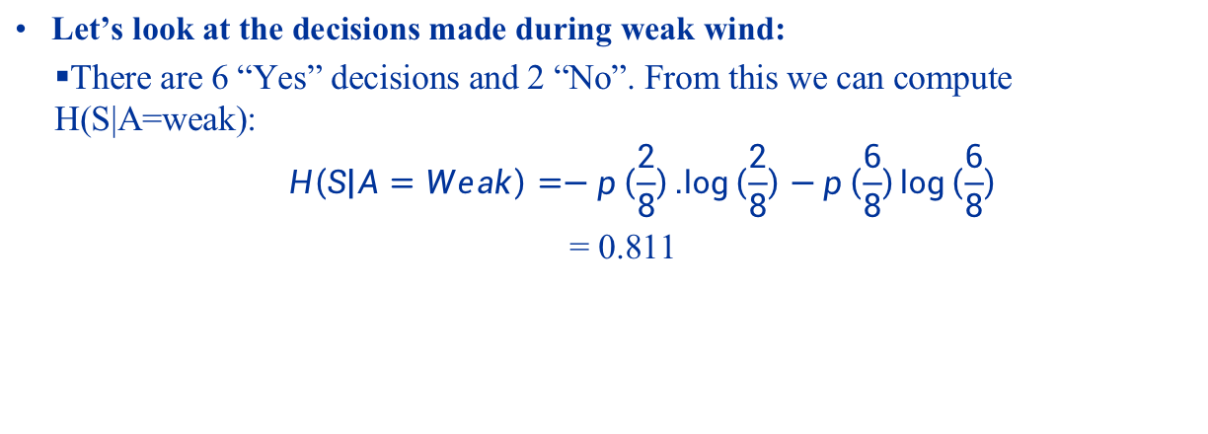
The ID3 Algorithm
Let’s look at the decisions made during weak wind:
There are 6 “Yes” decisions and 2 “No”. From this we can compute H(S|A=weak):
$$H\left(S | A=Weak\right)=−p\left(\frac{2}{8}\right).\log\left(\frac{2}{8}\right)−p\left(\frac{6}{8}\right)\log\left(\frac{6}{8}\right)$$
= 0.811

Slide 39
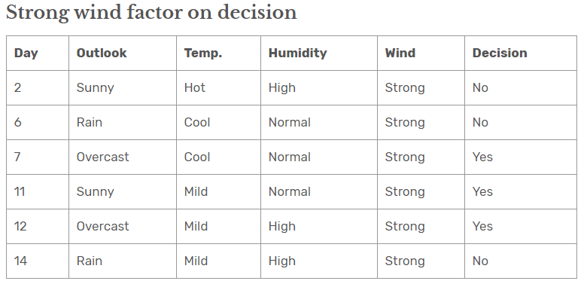
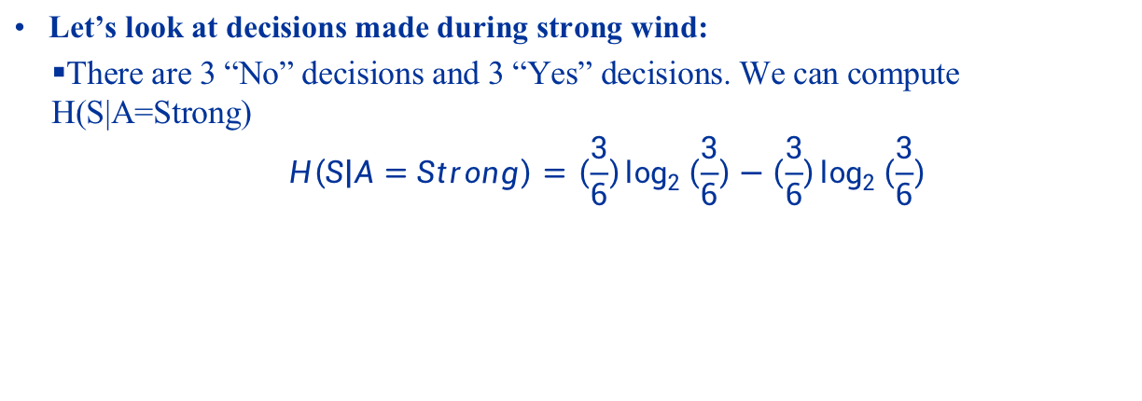
The ID3 Algorithm
Let’s look at decisions made during strong wind:
There are 3 “No” decisions and 3 “Yes” decisions. We can compute H(S|A=Strong)
$$H\left(S | A=Strong\right)=\left(\frac{3}{6}\right)\log_{2}\left(\frac{3}{6}\right)−\left(\frac{3}{6}\right)\log_{2}\left(\frac{3}{6}\right)$$

Slide 40
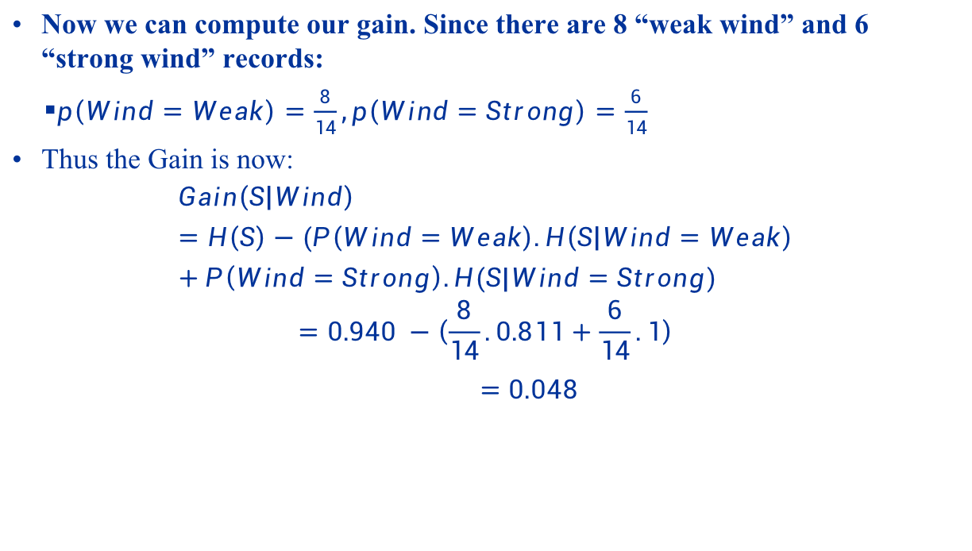
The ID3 Algorithm
Now we can compute our gain. Since there are 8 “weak wind” and 6 “strong wind” records:
$p\left(Wind=Weak\right)=\frac{8}{14},p\left(Wind=Strong\right)=\frac{6}{14}$
Thus the Gain is now:
$$Gain\left(S | Wind\right)=H\left(S\right)−(P\left(Wind=Weak\right).H\left(S | Wind=Weak\right)+P\left(Wind=Strong\right).H(S|Wind=Strong)$$
$$=0.940 −\left(\frac{8}{14}.0.811+\frac{6}{14}.1\right)$$
$=0.048$

Slide 41
The ID3 Algorithm
We repeat for all the columns and get:
The factor with the highest gain is 0.246, so we pick that as the root and get the following tree:
Factor | Gain
Wind | 0.048
Outlook | 0.246
Temperature | 0.029
Humidity | 0.151

Slide 42
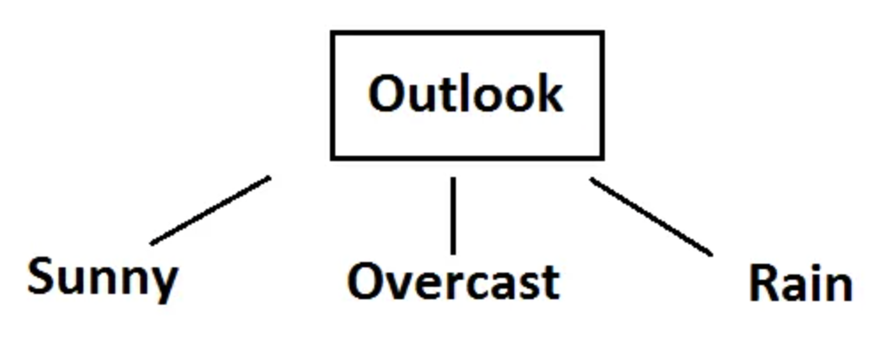
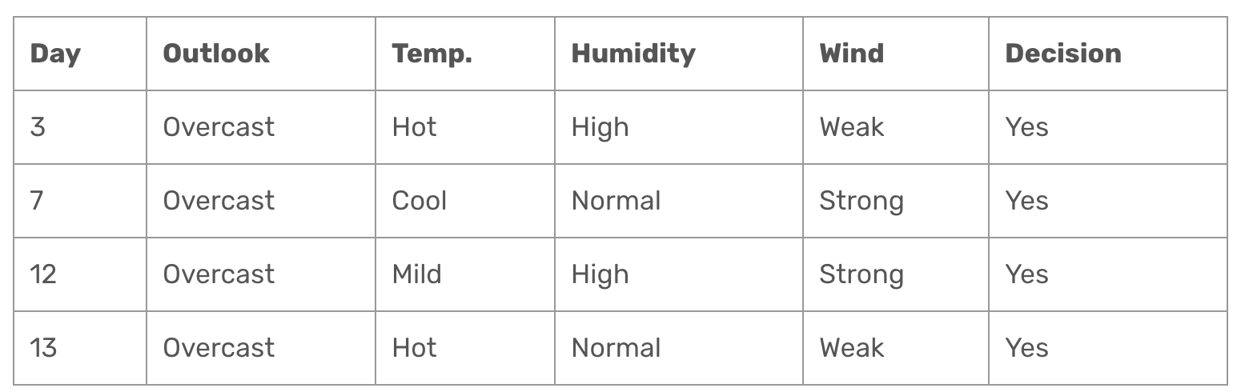
The ID3 Algorithm
There are three outcomes for Outlook: Sunny, Overcast, Rain. Let’s look at the decision history for these three outcomes.
First we look at Overcast. We find that the decision is always yes. We can stop here.

Slide 43
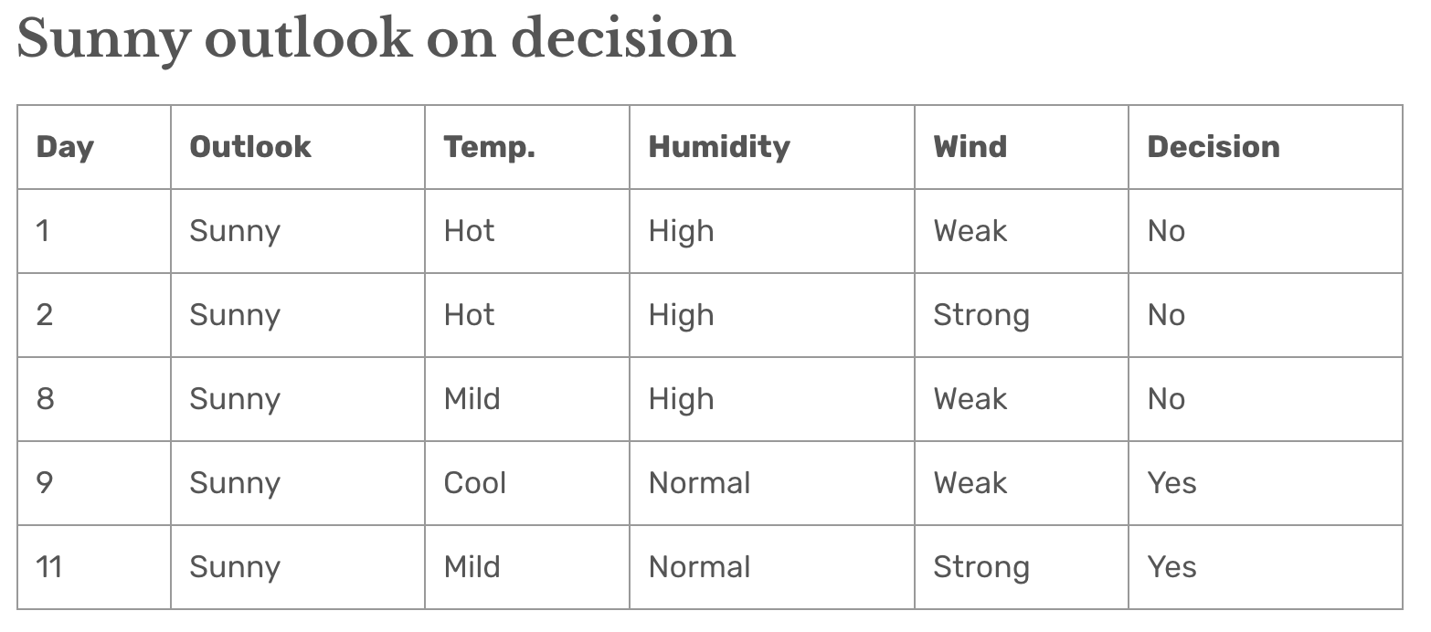
The ID3 Algorithm
We look at the outcome for Sunny:
We work out the gains for temperature, humidity and wind:
Factor | Gain
Temperature | 0.570
Humidity | 0.970
Wind | 0.019

Slide 44
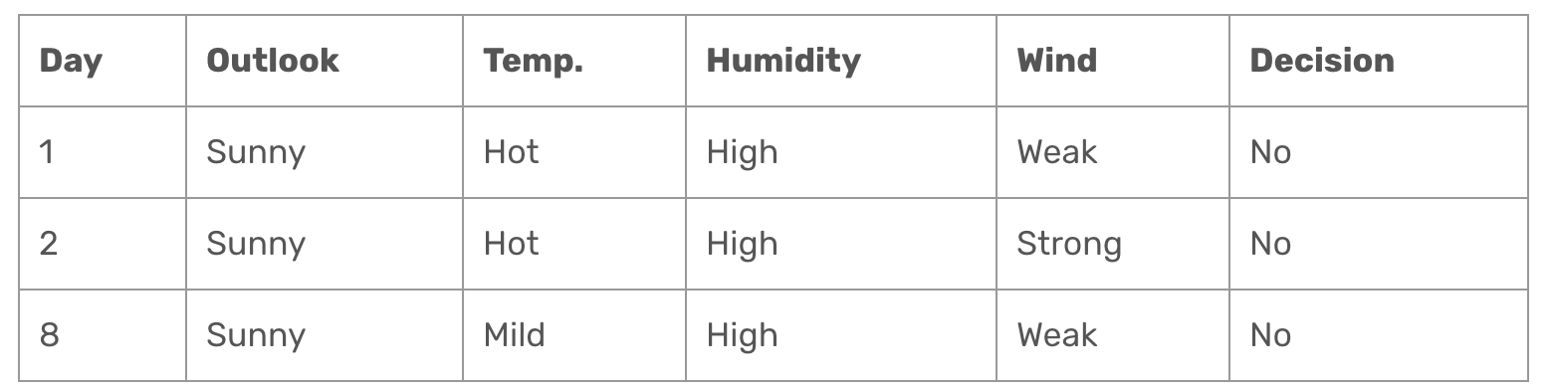
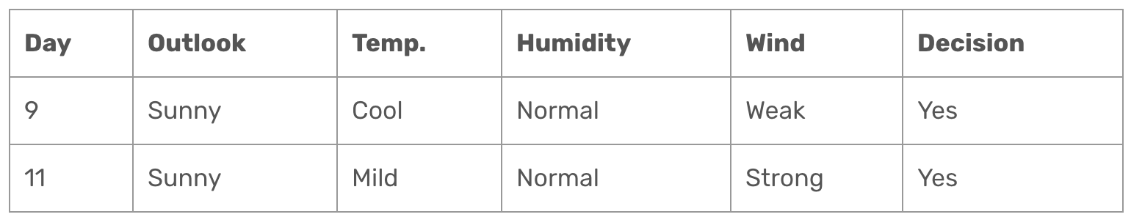
The ID3 Algorithm
Here humidity has the highest gain. There are two possible outcomes: “High” and “Normal”. We can look at the decisions made for both when it is sunny:
The decision is straightforward: Yes if humidity is normal, no if high.

Slide 45
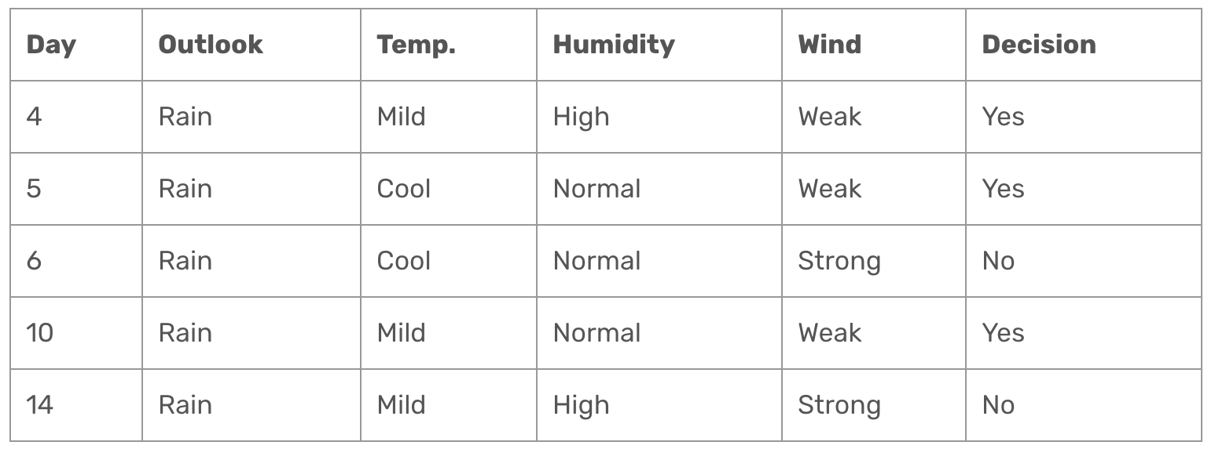
The ID3 Algorithm
Now let’s look at decisions when it is raining:
Let’s look at the gains for the remaining factors:
Factor | Gain
Temperature | 0.019973
Humidity | 0.019773
Wind | 0.9710

Slide 46
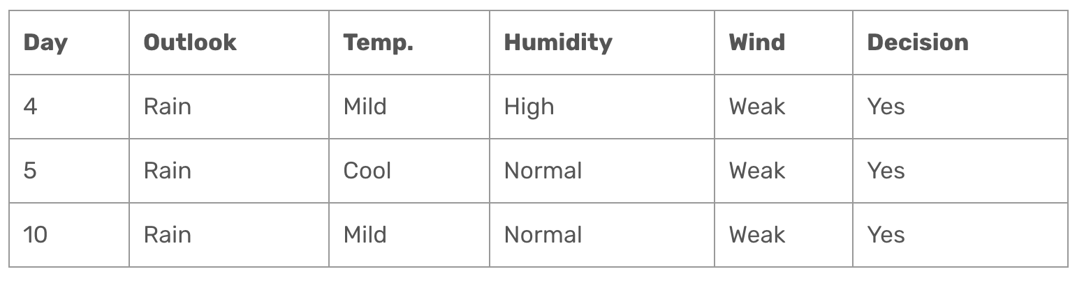
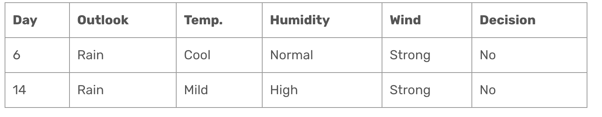
The ID3 Algorithm
Here Wind has the highest gain. There are two values: Strong and Weak. We can look at the decisions for both:

Slide 47
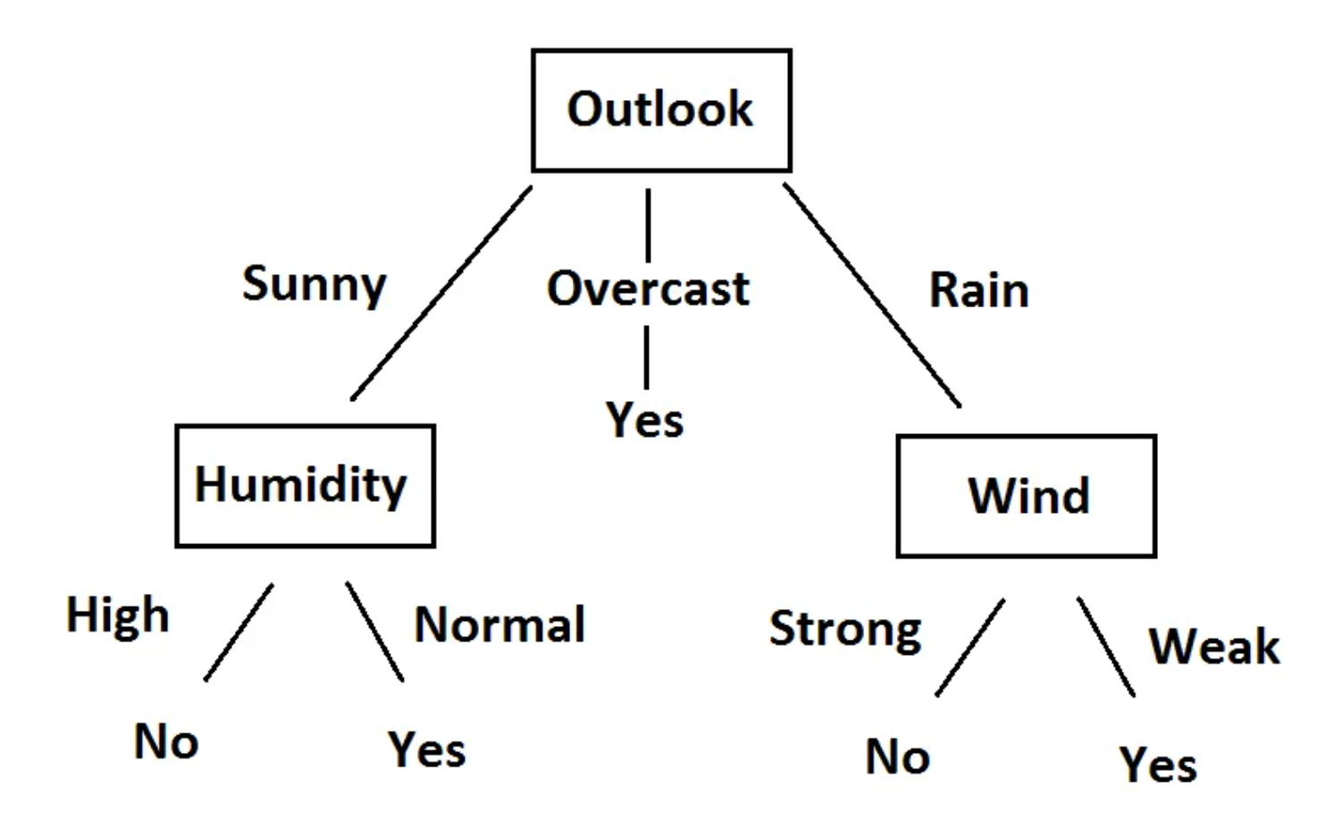
The ID3 Algorithm
So when it rains, we will always play when the wind is weak, and never when it is strong. We are done! This is how we decide whether or not to play tennis (or at least this is how Bob decides):

Slide 48
The C4.5 Algorithm, Regression Trees
The ID3 Algorithm has one drawback:
It only works with “nominal” values – i.e. each factor has values that are clear categories. It doesn’t work with continuous values.
The C4.5 algorithm addresses this. In addition the gains of each factor are also scaled by their entropies.
You can find the C4.5 algorithm described at: https://sefiks.com/2018/05/13/a-step-by-step-c4-5-decision-tree-example/
Here we use decision trees for classification. They can also be used for regression, but this will be outside the scope of this course. Please see https://sefiks.com/2018/08/28/a-step-by-step-regression-decision-tree-example/

Slide 49
Decision Trees Hands-on
Start up Jupyter and load the “DecisionTrees.ipynb” notebook.

Slide 50
Classification: support vector machines
SWS3009 Embedded Systems and Deep Learning

Slide 51
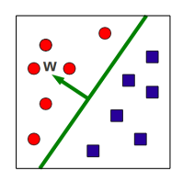

Support Vector Machines Separation Hyperplanes
A hyperplane is a d dimension plane defined by its normal vector w.
In 2D a hyperplane is a straight line, in 3D it is a standard plane.
The normal w is orthogonal to all points on the plane. I.e. for any point p on the plane, w^{T}p is 0.
The hyperplane separates the d-dimension space into two halves.
Hyperplanes always pass through the origin:
This restricts its ability to partition the space.
To fix this we add a d-dimension bias b.
Our goal:
To learn w and b such that given an input x:
$$w^{T}x+b>0 if x belongs to class A$$
$$w^{T}x+b<0 if x belongs to class B$$

Slide 52
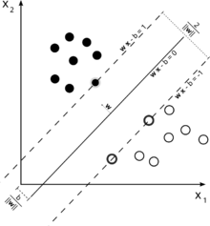
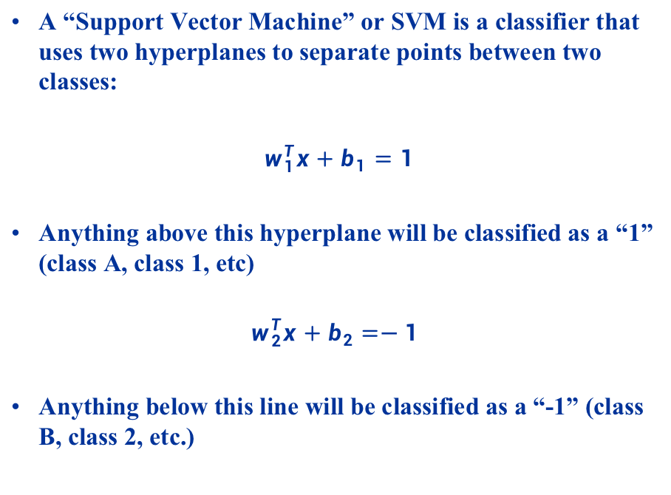
Support Vector Machines Assumptions
A “Support Vector Machine” or SVM is a classifier that uses two hyperplanes to separate points between two classes:
$w_{1}^{T}x+b_{1}=1$
Anything above this hyperplane will be classified as a “1” (class A, class 1, etc)
$$w_{2}^{T}x+b_{2}=−1$$
Anything below this line will be classified as a “-1” (class B, class 2, etc.)

Slide 53
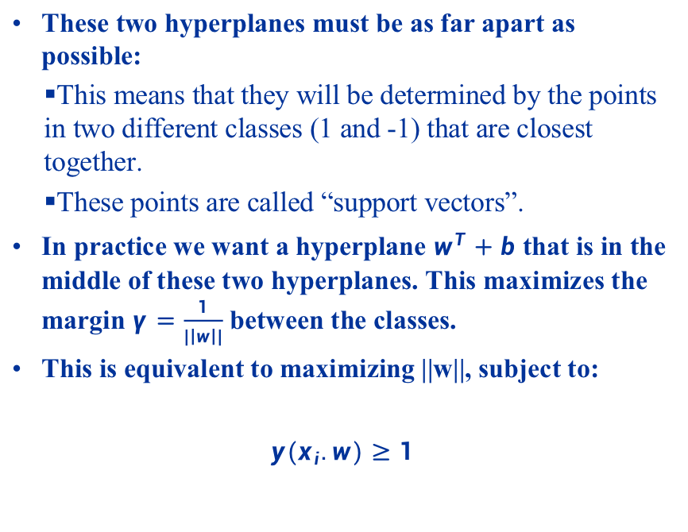
Support Vector Machines Assumptions
These two hyperplanes must be as far apart as possible:
This means that they will be determined by the points in two different classes (1 and -1) that are closest together.
These points are called “support vectors”.
In practice we want a hyperplane $w^{T}+b$ that is in the middle of these two hyperplanes. This maximizes the margin $γ=\frac{1}{|\left|w\right||}$ between the classes.
This is equivalent to maximizing ||w||, subject to:
$y(x_{i}.w)≥1$

Slide 54
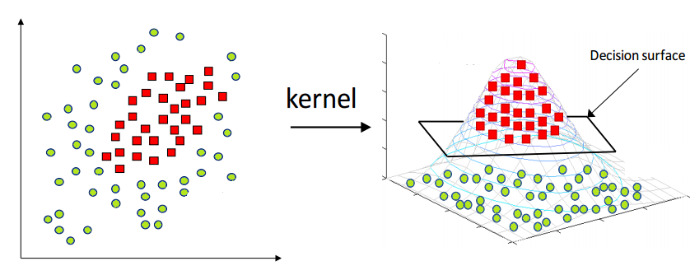
Support Vector Machines Non-Linearly Separable Points
The standard SVM can only classify linearly separable points. For points that are not linearly separable, SVMs can apply a “kernel trick”:
Choose a kernel function that maps the points to a higher dimension.
If properly chosen the higher dimension points should become linearly separable.

Slide 55
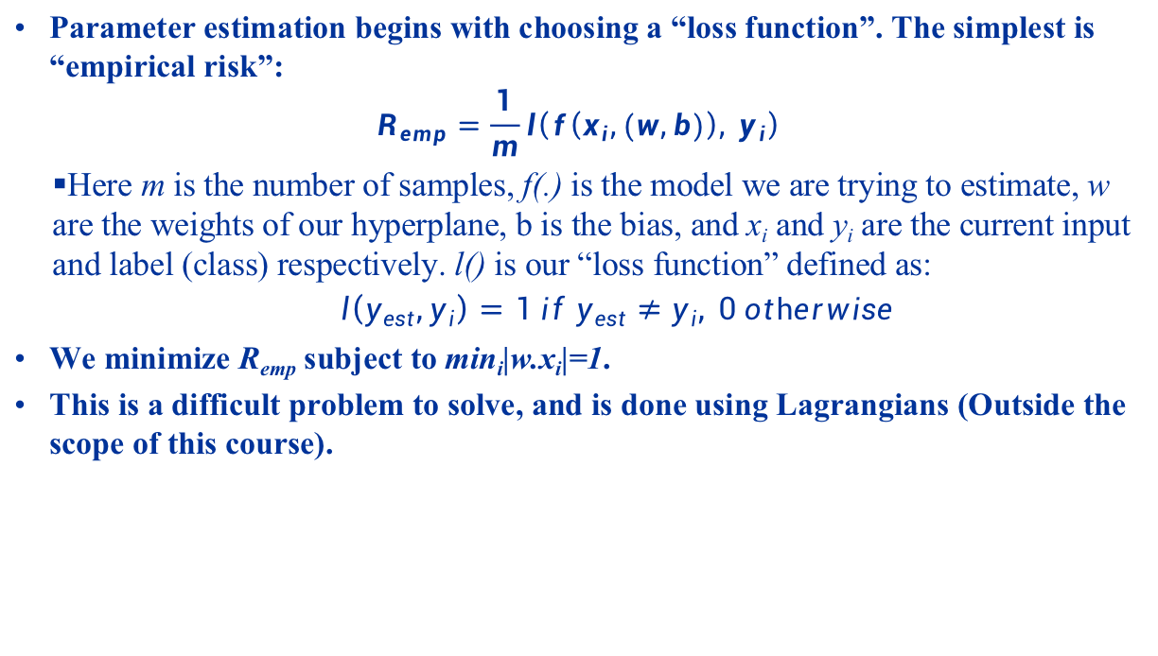
Support Vector Machines Parameter Estimation
Parameter estimation begins with choosing a “loss function”. The simplest is “empirical risk”:
$$R_{emp}=\frac{1}{m}l\left(f\left(x_{i},(w,b)\right), y_{i}\right)$$
Here m is the number of samples, f(.) is the model we are trying to estimate, w are the weights of our hyperplane, b is the bias, and x_{i} and y_{i} are the current input and label (class) respectively. l() is our “loss function” defined as:
$$l\left(y_{est},y_{i}\right)=1 if y_{est}≠y_{i}, 0 otherwise$$
We minimize R_{emp} subject to min_{i}|w.x_{i}|=1.
This is a difficult problem to solve, and is done using Lagrangians (Outside the scope of this course).

Slide 56
Support Vector Machines Configuration
There are several things we need to choose when using Linear SVMs:
Loss function:
Hinge Loss: Loss function used for linearly separable classes.
Logistic: Produces probability estimates of the classifications.
Perceptron: Loss function used by Perceptrons
Modified Huber: More tolerance to outliers (see later).
Training Rate (alpha): Controls how fast the SVM learns. Higher values can lead to poorer results, lower values can lead to slow training.

Slide 57
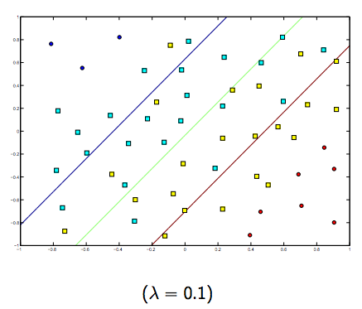
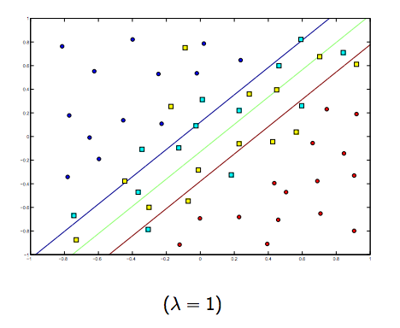
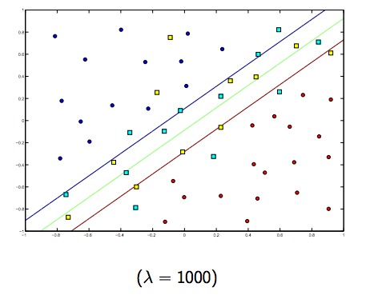
Support Vector Machines Configuration
Regularization: This controls how we penalize mis-classified information (i.e. information that should be in one class, but occurs in the space of another class - outliers):
Higher penalty: Possibly more overfitting – SVM can only understand and correctly classify training data and nothing else.
Lower penalty: Underfitting – SVM performs poorly even on training data.
The idea is to choose a regularization that allows some misclassified information, but not too much.
L1 – Adds a penalty term that uses the absolute value of the model parameters. Results in a model with fewer parameters.
L2 – Adds a penalty term that uses the square of the value of the model parameters. Produces denser models.
Elastic: Combines L1 and L2.

Slide 58
SVM Hands-on
Start up Jupyter and load the “SVM.ipynb” notebook.

Slide 59
Summary
Statistical methods make use of statistical assumptions about the data to build models:
Linear Regression: There is strong correlation between the variables.
Naïve Bayes: Statistical independence between variables.
Decision Trees: Clear decision paths inferred from past decision data.
Support Vector Machines: There exists a hyper-plane that can separate points.
Statistical methods are useful:
Simple to build, fast to train.
Can be more useful than neural networks when the data is relatively simple.
Can be good to “test” data to see if it is possible to even build machine learning models for it.
E.g. in the temperature-location example we did in Lab 1, there is little deviation in temperature across the whole of Singapore.
Unlikely to be able to train a machine learning model to predict temperature based on location – indeed we failed in doing so.

